Slide 1
Examples of FOG-EDGE-CLOUD computing in IOT

Slide 2
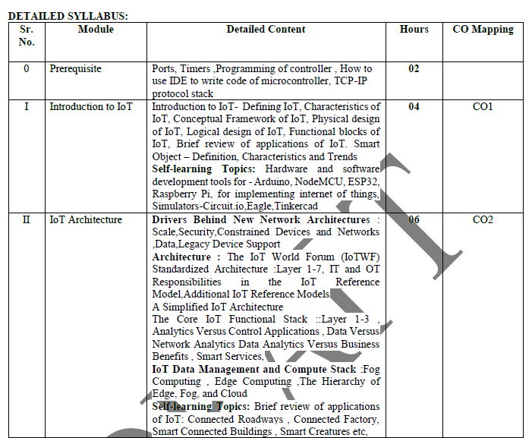

Slide 3
IOT DATA MANAGEMENT AND COMPUTE STACK
The massive scale of IoT networks is fundamentally driving new architectures. As per the projections by Cisco nearly 50 billion devices will be connected to the IoT networks by the year 2020.
In fact, the data generated by IoT sensors is one of the single biggest challenges in building an IoT system.
In the case of modern IT networks, the data sourced by a computer or server is typically generated by the client/server communications model, and it serves the needs of the application.
In sensor networks, the vast majority of data generated is unstructured and of very little use on its own.
In most cases, the processing location is outside the smart object. A natural location for this processing activity is the cloud.
Smart objects need to connect to the cloud, and data processing is centralized.
One advantage of this model is simplicity. Objects just need to connect to a central cloud application.
This model also has some limitations.
The data volume increases with more number of smart objects being connected to the network which in turn creates a new requirements.

Slide 4
These new requirements include the following
1. Minimizing latency
2. Conserving network bandwidth
3. Increasing local efficiency

Slide 5
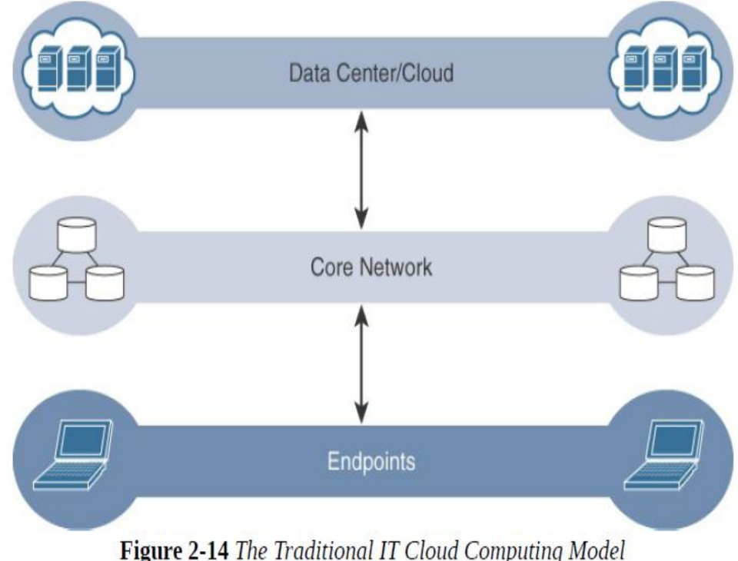

Slide 6
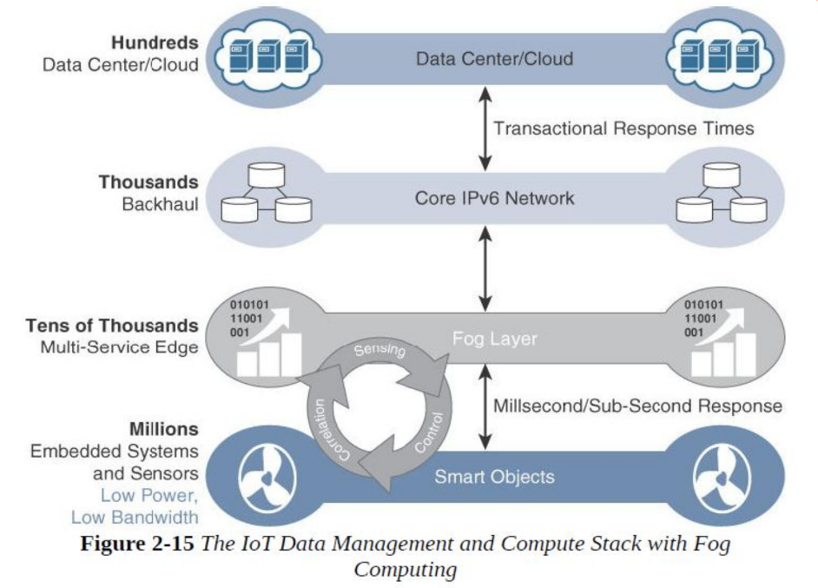

Slide 7
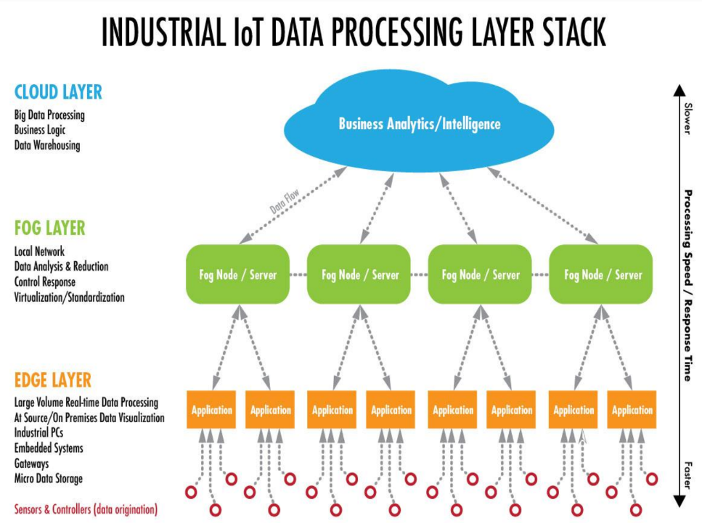

Slide 8
Edge Computing
In edge computing, the data generated by these devices are stored and computed at the device itself, and the system doesn’t look at sharing this data with the cloud.
An edge solution should support the most common protocols. For example, these include Z-Wave, ZigBee, KNX, Bluetooth LE, HomeConnect, Modbus, ONVIF, EnOcean, BACnet, OPC UA, LoRa, Siemens S7.

Slide 9
Edge computing: Need
There are several reasons why the edge computing market is increasing rapidly.
In addition to the greater number of connected devices, there are three key drivers of growth for edge computing:
Latency — For many time-sensitive applications, the process being monitored requires a response in near real time, with near-zero latency. In these situations a round trip of data to and from the cloud or a corporate data center is impractical.
Bandwidth — Both the physical limits of available bandwidth and the cost of transmitting large quantities of data make edge computing an attractive alternative.
Reliability — Network congestion can interrupt the flow of data, causing unacceptable interruptions in use cases such as point-of-sale systems.

Slide 10
Examples of Edge
Autonomous Vehicles, Electric Vehicles and Charging Stations
Edge computing features such as lane-departure warning and self-parking applications are already widely available.
And as the ability of vehicles to interact with their environment becomes more widespread, so will the need for a fast and responsive network.
Autonomous vehicles will operate in concert with other connected vehicles,
traffic management systems,
roadside units and
pedestrians on busy thoroughfares and at intersections.

Slide 11
Electric vehicles:
need continuous monitoring and can use edge computing for management of data to support predictive maintenance.
EV batteries must be monitored, as their longevity depends on the individual habits of drivers, the congestion of the areas they travel and how often they are charged.
Edge computing supports data aggregation to report the actionable data for performance and maintenance.
In EV charging stations:
edge computing can support
real time monitoring and data aggregation of a range of usage and
availability metrics to support optimization of charging stations and
planning for placement of future stations.

Slide 12
Traffic Management Systems: Highly sophisticated systems today, like New York City's traffic management system,
can adjust the timing of traffic signals,
manage the opening and closing of extra traffic lanes,
ensure communications can continue in the case of a public emergency, and
take other real-time actions to improve safety and convenience.
In public transit applications, edge computing systems installed in buses, passenger rail systems and paratransit vehicles can
aggregate and send only the data needed for to support in-vehicle processes and
dispatcher insights.
Smart Cities, Clean Energy and Green Technology: The green tech movement is growing. Cities and smart grid systems can use edge computing devices
to monitor public buildings and facilities for greater efficiency in
lighting,
heating,
clean energy and more.

Slide 13
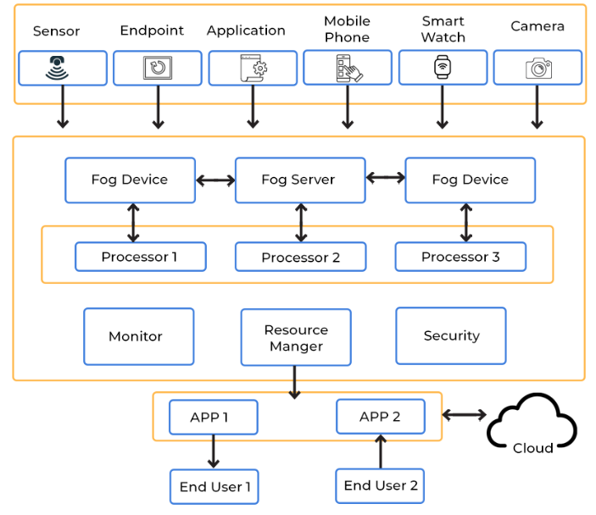
FOG Computing
Any device with computing, storage, and network connectivity can be a fog node.
Examples include:
industrial controllers,
switches,
routers,
embedded servers, and
video surveillance cameras.

Slide 14
FOG computing
Application of Fog Computing
It's utilized when only a small amount of data has to be sent to the cloud. This data is chosen for long-term storage and is accessed by the host less frequently.
It's utilized when a large number of services must be delivered over a broad region and at various places.
Fog computing is required for devices that are subjected to demanding calculations and processing.
Fog computing is utilized in IoT devices (for example, the Car-to-Car Consortium in Europe), Devices with Sensors and Cameras (IIoT-Industrial Internet of Things), and other applications.

Slide 15
The characteristic of fog computing are as follows:
The characteristic of fog computing are as follows:
1. Contextual location awareness and low latency
2. Geographic distribution
3. Deployment near IoT endpoints
4. Wireless communication between the fog and the IoT endpoint
5. Use for real-time interactions

Slide 16
Advantages of Fog Computing
The quantity of data that has to be transmitted to the cloud is reduced using this method.
Because the distance that data has to travel is decreased, network bandwidth is saved.
Reduces the system's reaction time.
Because the data is kept near to the host, it increases the system's overall security.

Slide 17
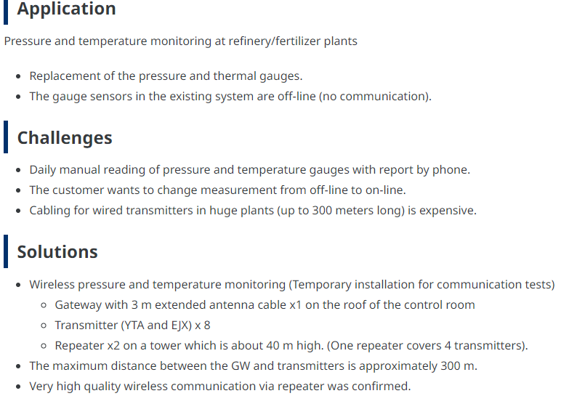

Slide 18
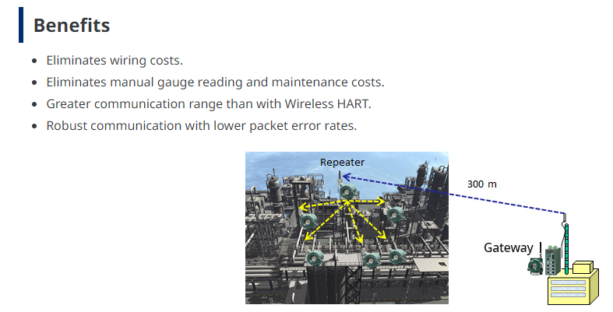
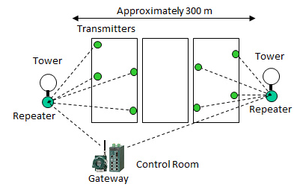

Slide 19
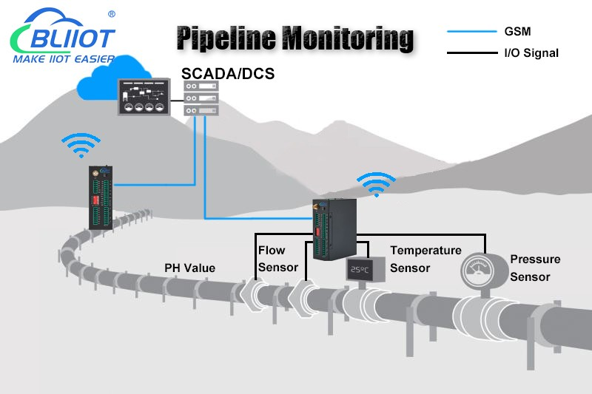

Slide 20
Description/scope of the work:
Automate the process of measurement of remote parameters like flow, pressure temp and Ph value of the liquid flowing through the pipeline
Collect the data and present the real time average value of the parameter to the supervisor on the field. Present the same to supervisor in control room
Detect the anomalies and notify the concerned persons. Compare the same with the historical data
Update the Schedule for the maintenance
Compare the up and down time and the quantity delivered through various pipelines over one years of span

Slide 21
Automate the process of measurement of remote parameters like flow, pressure temp and Ph value of the liquid flowing through the pipeline
Edge
Install the sensors - flow, temp, pressure, ph for measurement Read the parameter with the sampling rate of every sec. Compute the average value Send it to the fog level device
Fog
Store the average value of all the parameters in tabular/structured format

Slide 22
 | Edge | Fog | Cloud
2. Collect the data and present the real time average value of the parameter to the supervisor on the field. Present the same to supervisor in control room | Fetch the stored values in a structured format and present it to the supervisor in the field | Fetch the stored values in a structured format to be presented to the supervisor in the control room | Send the data to cloud for further processing

Slide 23
 | Edge | Fog | Cloud
Detect the anomalies and notify the concerned persons. Compare the same with the historical data | Compare the data with the set point to detect the anomalies Notify the anomalies to the supervisor Detect the critical situation and notify | Get the details of the occurrences of the anomalies. Update the records and send it to the cloud for comparison purposes and | Analyse the anomalies in the larger window frame

Slide 24
 | Edge | Fog | Cloud
Update the Schedule for the maintenance | Notify the scheduled activities | Fetch the schedule from the cloud and send it to the field Notify the scheduled activities to the local people and control room | Use the analysis done for scheduling the maintenance

Slide 25
 | Edge | Fog | Cloud
Compare the up and down time and the quantity delivered through various pipelines over one years of span |  | Identify if the sensor is live or dead - through inference And update the record of up or downtime of the pipeline along with the maintenance schedule. | Analyse the down time Analyse the quantity delivered by each pipeline Analyse the throughput of every pipeline and downtime Identify the reason if any

Slide 26
 | Edge | Fog | Cloud
Automate the process of measurement of remote parameters like flow, pressure temp and Ph value of the liquid flowing through the pipeline | Install the sensors - flow, temp, pressure, ph for measurement Read the parameter with the sampling rate of every sec. Compute the average value Send it to the fog level device | Store the average value of all the parameters in tabular/structured format
Collect the data and present the real time average value of the parameter to the supervisor on the field. Present the same to supervisor in control room | Fetch the stored values in a structured format and present it to the supervisor in the field | Fetch the stored values in a structured format to be presented to the supervisor in the control room | Send the data to cloud for further processing
Detect the anomalies and notify the concerned persons. Compare the same with the historical data | Compare the data with the set point to detect the anomalies Notify the anomalies to the supervisor Detect the critical situation and notify | Get the details of the occurrences of the anomalies. Update the records and send it to the cloud for comparison purposes and | Analyse the anomalies in the larger window frame
Update the Schedule for the maintenance | Notify the scheduled activities | Fetch the schedule from the cloud and send it to the field Notify the scheduled activities to the local people and control room | Use the analysis done for scheduling the maintenance
Compare the up and down time and the quantity delivered through various pipelines over one years of span |  | Identify if the sensor is live or dead - through inference And update the record of up or downtime of the pipeline along with the maintenance schedule. | Analyse the down time Analyse the quantity delivered by each pipeline Analyse the throughput of every pipeline and downtime Identify the reason if any

Slide 27
Autonomous Vehicles Requirements - The vehicle should be able to
Autonomous vehicles will operate in concert with other connected vehicles,
traffic management systems,
roadside units and
pedestrians on busy thoroughfares and at intersections.
Detect the presence of the obstacles and control the speed and direction accordingly
Give lane-departure warning and and be able to do self-parking
Send the route information to the central system for storage and to be made available to the supervisor to monitor the performance of the vehicle in real time
Data will be accessed by various other zonal people for R & D
The performance of the vehicle will be monitored and the vehicle will be tracked in real time to detect any unforeseen situation
The history of the vehicle performance need to be maintained and the abstract level information in the form of fuel used, time taken to cover different routes along with route information mapped to GPS, accidents taken place if any, etc will be sent to the R & D department situated in other city/country
The records of modification taken place to improve the performance of the vehicle also to be maintained at the central level
Keep a track of sensor failure over the period of time
etc

Slide 28
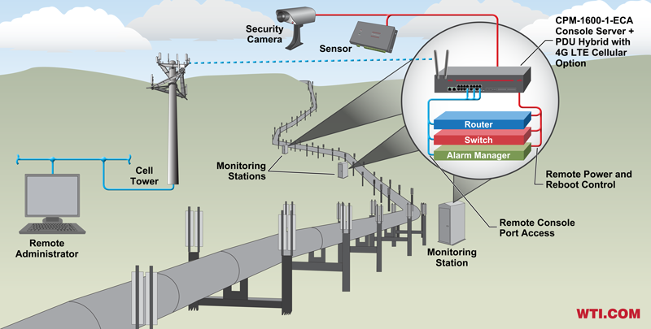

Slide 29
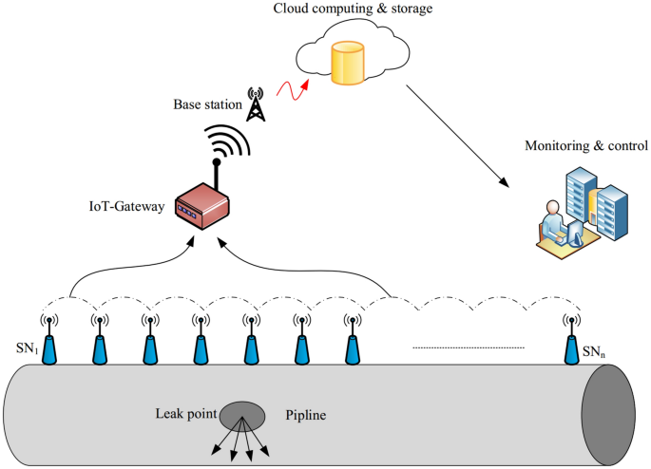

Slide 30
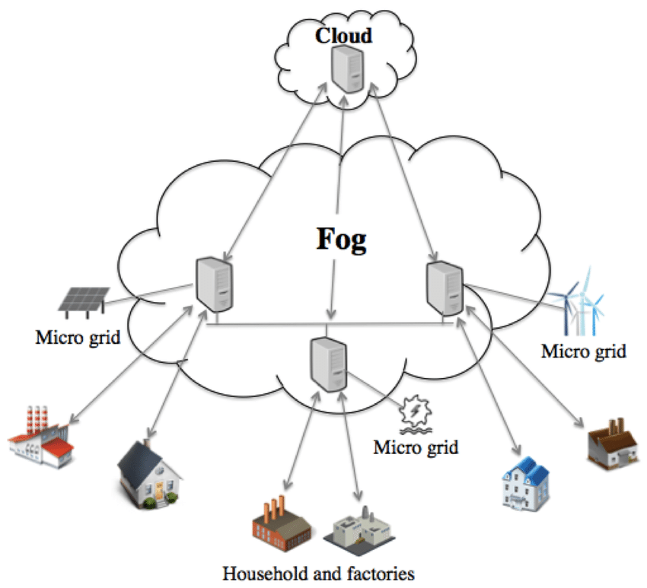

Slide 31
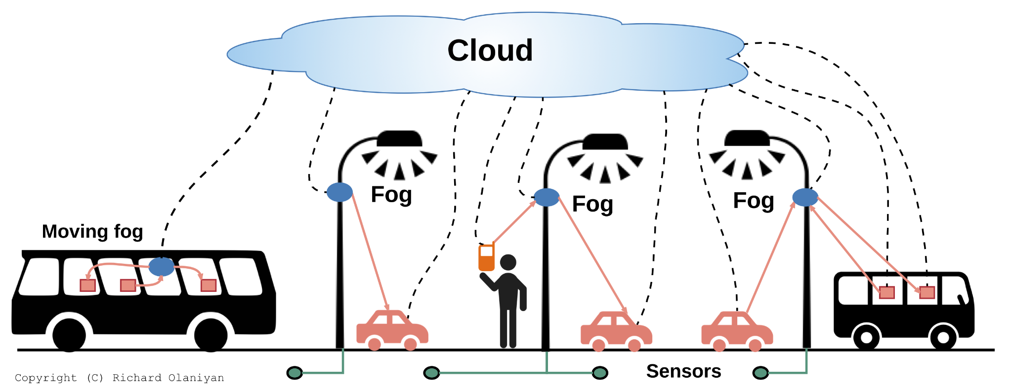

Slide 32
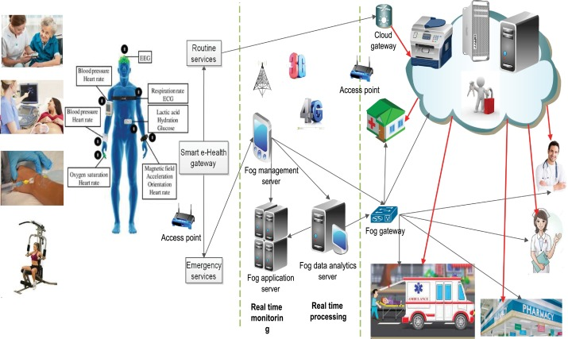

Slide 33
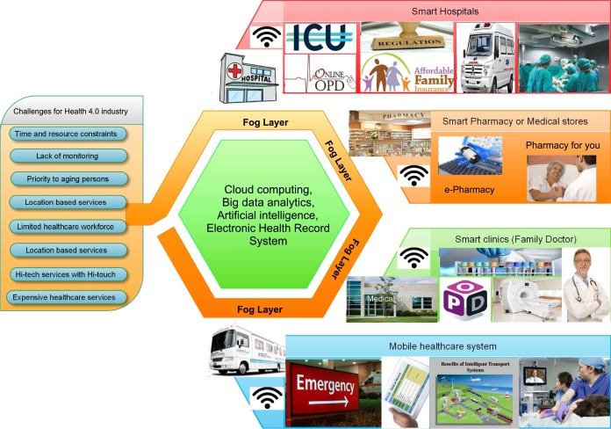

Slide 34
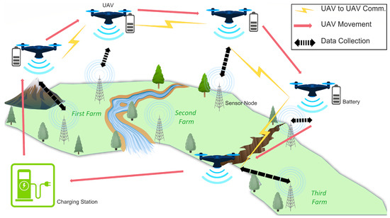

Slide 35
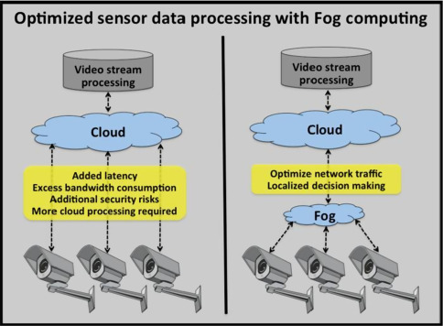

Slide 36
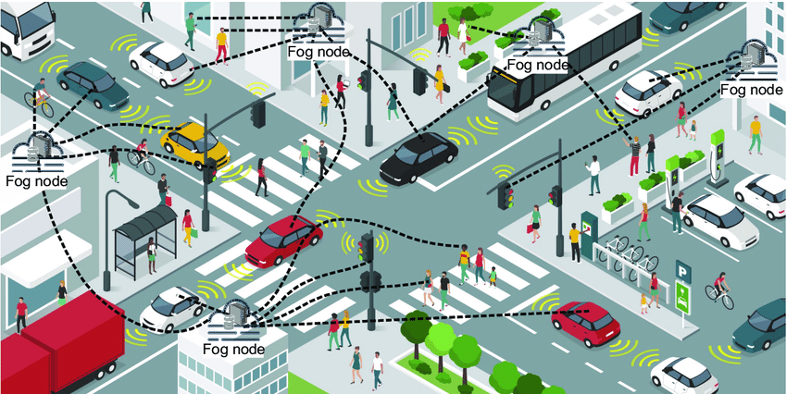
Intelligent transportation system

Slide 37
Application of FOG
1. Smart homes One of the most common fog computing use cases is a smart home. A smart home consists of
a technology-controlled ventilation and heating system such as the Nest Learning Thermostat,
smart lighting,
programmable shades and sprinklers,
smart intercom systems to communicate with people indoors as well as those at the door, and
an intelligent alarm system.
Fog computing can be used to create a personalized alarm system. It can also be used to automate certain events, such as turning on water sprinklers based on time and temperature.

Slide 38
2. Smart cities Smart cities aspire to be automated at every front, from garbage collection to traffic management.
Fog computing is particularly pertinent when it comes to traffic regulation.
Sensors are set up at traffic signals and road barriers for detecting pedestrians, cyclists, and vehicles.
Speedometers can measure how fast they are traveling and how likely it can result in a collision.
These sensors use wireless and cellular technology to collect this data.
Traffic signals automatically turn red or stay green for a longer time based on the information processed from these sensors.

Slide 39
3. Video surveillance The most prevalent example of fog computing is perhaps video surveillance, given that continuous streams of videos are large and cumbersome to transfer across networks.
The nature of the involved data results in latency problems and network challenges.
Costs also tend to be high for storing media content.
Video surveillance is used in malls and other large public areas and has also been implemented in the streets of numerous communities.
Fog nodes can detect anomalies in crowd patterns and automatically alert authorities if they notice violence in the footage.

Slide 40
4. Healthcare
The healthcare industry is one of the most governed industries, with regulations such as HIPAA being mandatory for hospitals and healthcare providers.
This sector is always looking to innovate and address emergencies in real-time, such as a drop in vitals.
One way of doing it is using data from wearables, blood glucose monitors, and other health apps to look for signs of bodily distress.
This data should not face any latency issues as even a few seconds of delay can make a huge difference in a critical situation, such as a stroke.

Slide 41
5. Others Other industries that use fog computing include retail, oil & gas, government & military, and hospitality. Personal assistants such as Siri and Alexa are available across devices and are compatible with most, such as smartwatches.
This flexibility and presence mean that we can count on fog computing to become a crucial part of various industry verticals. Any enterprise that offers real-time solutions will need to incorporate fog computing into its existing cloud infrastructure.

Slide 44
Cloud Computing
Cloud computing is
mainly to store, process and analyze massive volumes of data for deeper insights using powerful data analytics enginesand ML mechanisms which edge computing never be able to support
It contributes to
reduce the downtime and energy consumption
Increase the production rate
Optimization
Capacity planning etc

Slide 45
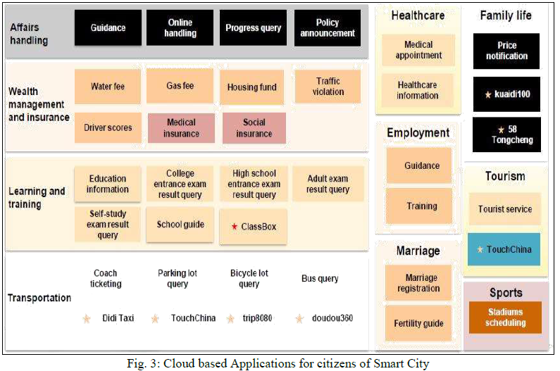

Slide 46
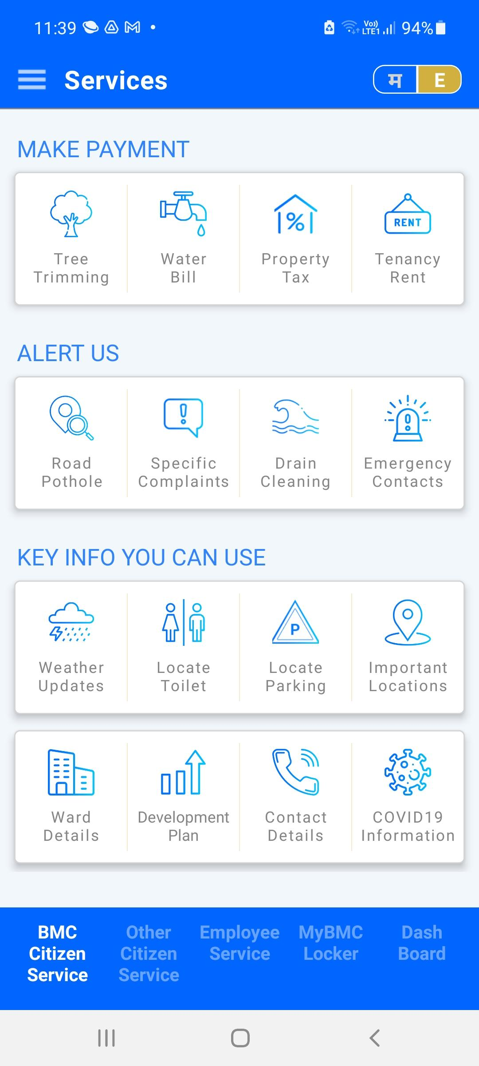
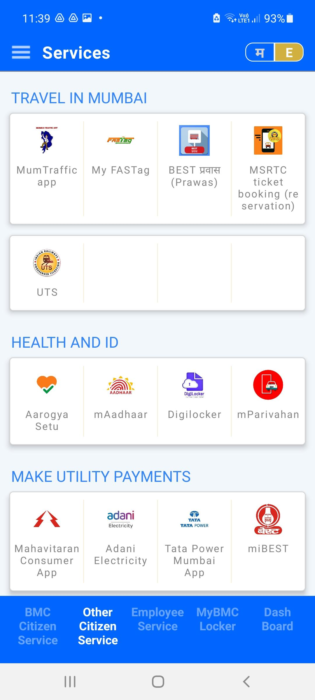

MyBMC App

Slide 47
Applications
Connected Roadways
Connected factories
Smart connected buildings
Smart creatures
Population monitoring
Railway surveillance system
Railway track monitoring system
Train monitoring and reporting system
Every group will
Select one example
Identify the layer specific actions/responses/activities (for each layer - edge - fog - cloud)
Identify the sensors/actuators required
Identify the best suited protocols
Select the architecture
Identify the information needed to be sent at the higher level

Slide 48
Autonomous Vehicles Requirements - The vehicle should be able to
Autonomous vehicles will operate in concert with other connected vehicles,
traffic management systems,
roadside units and
pedestrians on busy thoroughfares and at intersections.
Detect the presence of the obstacles and control the speed and direction accordingly
Give lane-departure warning and and be able to do self-parking
Send the route information to the central system for storage and to be made available to the supervisor to monitor the performance of the vehicle in real time
Data will be accessed by various other zonal people for R & D
The performance of the vehicle will be monitored and the vehicle will be tracked in real time to detect any unforeseen situation
The history of the vehicle performance need to be maintained and the abstract level information in the form of fuel used, time taken to cover different routes along with route information mapped to GPS, accidents taken place if any, etc will be sent to the R & D department situated in other city/country
The records of modification taken place to improve the performance of the vehicle also to be maintained at the central level
Keep a track of sensor failure over the period of time
etc

Slide 49
Autonomous Vehicles
Edge computing features such as lane-departure warning and self-parking applications are already widely available.
And as the ability of vehicles to interact with their environment becomes more widespread, so will the need for a fast and responsive network.
Autonomous vehicles will operate in concert with other connected vehicles,
traffic management systems,
roadside units and
pedestrians on busy thoroughfares and at intersections.

Slide 50
Railway track monitoring system
Assumption :
The Railway works in 4 region: Eastern railway -western -southern -northern
Requirements
Monitor the health of the tracks like cracks - expansion - deformation - rusting
Monitor the wooden sleepers kept below the track
Maintenance - cost, schedule, planned and under emergency, Climate specific maintenance
Monitor the environmental condition - temp rainfall, foggy or clear
Usage of track from the daily up/down trains on the track
History of the trac - right from the beginning
Records of accidents
Track of Diversions taken from the main route
Connectivity of the tracks
All the information should be made available to the higher ups at local zonal and central/ministry level.
Based on the traffic the railway ministry should be able to plan for capacity building / future plan
System for measurement of acceleration on both side of one Axle and Bogie pivot on coach floor.
System for video recording of track components and analysis by image processing for condition monitoring of track components
The system shall be capable for recording of accurate location of all defects using some proven navigation system which may include tachometer and automatic location detector with route feature file or GPS with route feature files having GPS coordinates.
The TIMS shall be capable of monitoring all parameters of various sub systems in both forward and reverse directions accurately to avoid need for turning of coach.
The facility shall be provided for processed data transfer from TIMS to divisional and Zonal headquarters of concerned Railways and R.D.S.O (For initial 3 months). This facility shall be provided through GPRS/ other suitable mobile networks.
The System shall be capable of on line (during recording) processing, analysis, storage, reporting and printing of the recorded data/reports. Option to take or not to take the print of exception report and analogue report shall be available to user.
The system shall be capable of generating exception reports exceeding predefined limits of acceleration where accelerometer has been mounted, in the desired format
PARAMETERS TO BE RECORDED:
5.1 System for measurement of acceleration on both side of one Axle and Bogie pivot on coach floor.i. Measurement of vertical and lateral acceleration on both sides of one axle at user selectable sampling interval in distance domain and on various track features.
ii. Measurement of vertical and lateral acceleration on coach floor at bogie pivot at user selectable sampling interval in distance domain and on various track features.System for video recording of track components and analysis by image processing for condition monitoring of track components System shall be capable of identifying and reporting defects in rails, sleepers, fastenings and ballast deficiency. Following defects shall be identified in each track component.

Slide 51
System for measurement of acceleration on both side of one Axle and Bogie pivot on coach floor.
System for video recording of track components and analysis by image processing for condition monitoring of track components
System on both ends of coach for rear window video recording of track
The system shall be capable for recording of accurate location of all defects using some proven navigation system which may include tachometer and automatic location detector with route feature file or GPS with route feature files having GPS coordinates. The accuracy for reporting location of defect shall be better than 1.0 meter.
All data of TIMS exception reports shall be stored in a database or ASCII file which shall be compatible for uploading in TMS. Format of TMS data will be provided after award of Contract.
LASER printer/printers shall be used for on line printing of all type of reports being generated by different sub-systems.
The TIMS shall be capable of monitoring all parameters of various sub systems in both forward and reverse directions accurately to avoid need for turning of coach.
The facility shall be provided for processed data transfer from TIMS to divisional and Zonal headquarters of concerned Railways and R.D.S.O (For initial 3 months). This facility shall be provided through GPRS/ other suitable mobile networks.

Slide 52
System for measurement of acceleration on both side of one Axle and Bogie pivot on coach floor.
System shall be capable for measurement of vertical and lateral acceleration at axle box level and on pivot at coach floor level in time domain.
The accelerometer mounted on axle box and coach shall be capable to measure the maximum acceleration of +12g and +2g respectively.
The System shall be capable of on line (during recording) processing, analysis, storage, reporting and printing of the recorded data/reports. Option to take or not to take the print of exception report and analogue report shall be available to user.
The system shall be capable of generating exception reports exceeding predefined limits of acceleration where accelerometer has been mounted, in the desired format. Facility to change the limits shall also be available.
The acceleration value shall also be measured and printed on track features snapshot taken by video recording system.

Slide 53
The accelerometer mounted on axle box and coach shall be capable to measure the maximum acceleration of +12g and +2g respectively.
iii) The System shall be capable of on line (during recording) processing, analysis, storage, reporting and printing of the recorded data/reports. Option to take or not to take the print of exception report and analogue report shall be available to user.
The system shall be capable of generating exception reports exceeding predefined limits of acceleration where accelerometer has been mounted, in the desired format. Facility to change the limits shall also be available.
OK
vi) The acceleration value shall also be measured and printed on
track features snapshot taken by video recording system.
PARAMETERS TO BE RECORDED:
5.1 System for measurement of acceleration on both side of one Axle and Bogie pivot on coach floor.i. Measurement of vertical and lateral acceleration on both sides of one axle at user selectable sampling interval in distance domain and on various track features.
ii. Measurement of vertical and lateral acceleration on coach floor at bogie pivot at user selectable sampling interval in distance domain and on various track features.System for video recording of track components and analysis by image processing for condition monitoring of track components System shall be capable of identifying and reporting defects in rails, sleepers, fastenings and ballast deficiency. Following defects shall be identified in each track component.

